Slide 1
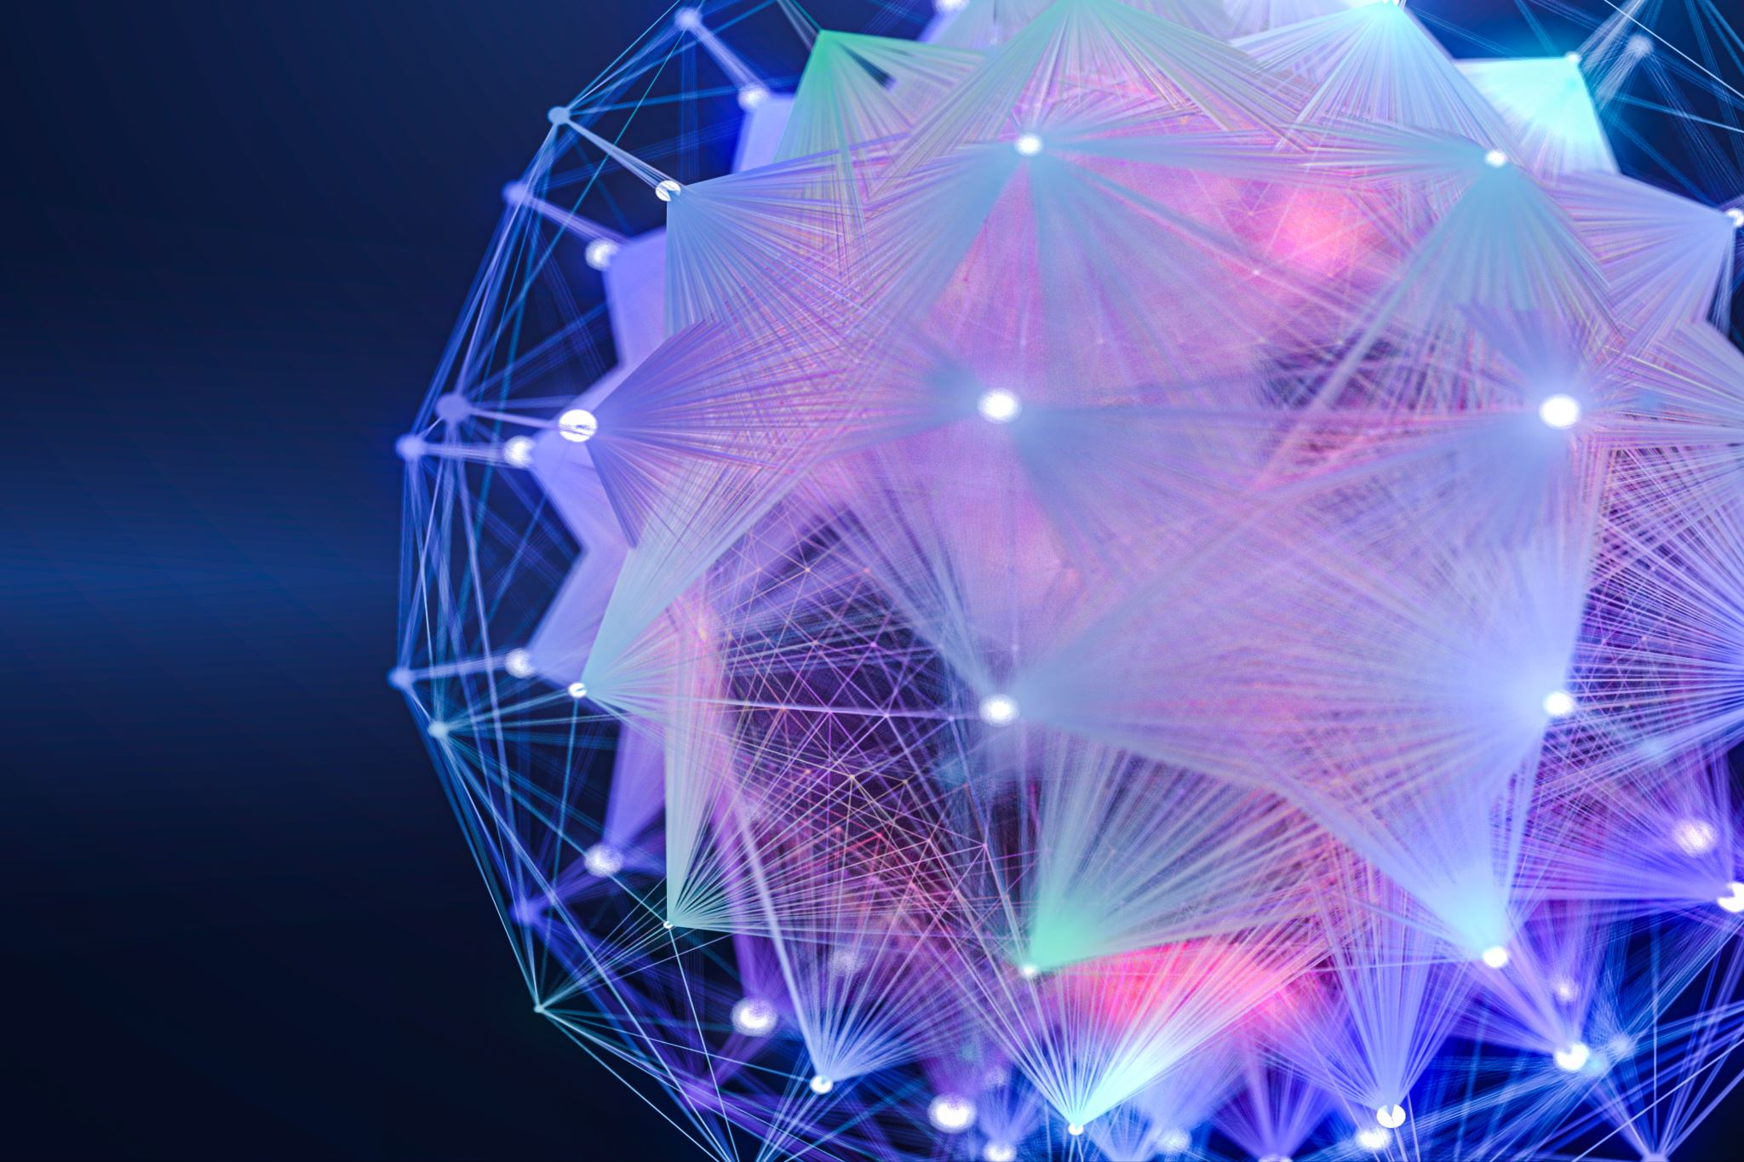
Leveraging Generative Artificial Intelligence (Al)
September 20, 2023
Presented by: Dan Hughes, Co-founder
dan@claritee.ai
Claritee.AI

Slide 2
Agenda
Generative AI & ChatGPT?
Key Concepts
Use Cases

Slide 3
Only the Tip of the Iceberg
ChatGPT
Generative AI
Notes:
Large Language Models (LLM) – Trained on vast amounts of data & algorithms and can understand and generate human-like text.
Natural Language Understanding (NLU) - Enables machines to comprehend and interpret human language.
Natural Language Generation (NLG) - Creating human-like text from data or pre-existing text, enabling machines to communicate with people in a natural and intuitive way.

Slide 4
Artificial Intelligence Tools
Artificial Intelligence (AI)
Supervised Learning
Generative AI
Reinforcement
Learning
Unsupervised
Learning
Notes:
Large Language Models (LLM) – Trained on vast amounts of data & algorithms and can understand and generate human-like text.
Natural Language Understanding (NLU) - Enables machines to comprehend and interpret human language.
Natural Language Generation (NLG) - Creating human-like text from data or pre-existing text, enabling machines to communicate with people in a natural and intuitive way.

Slide 5
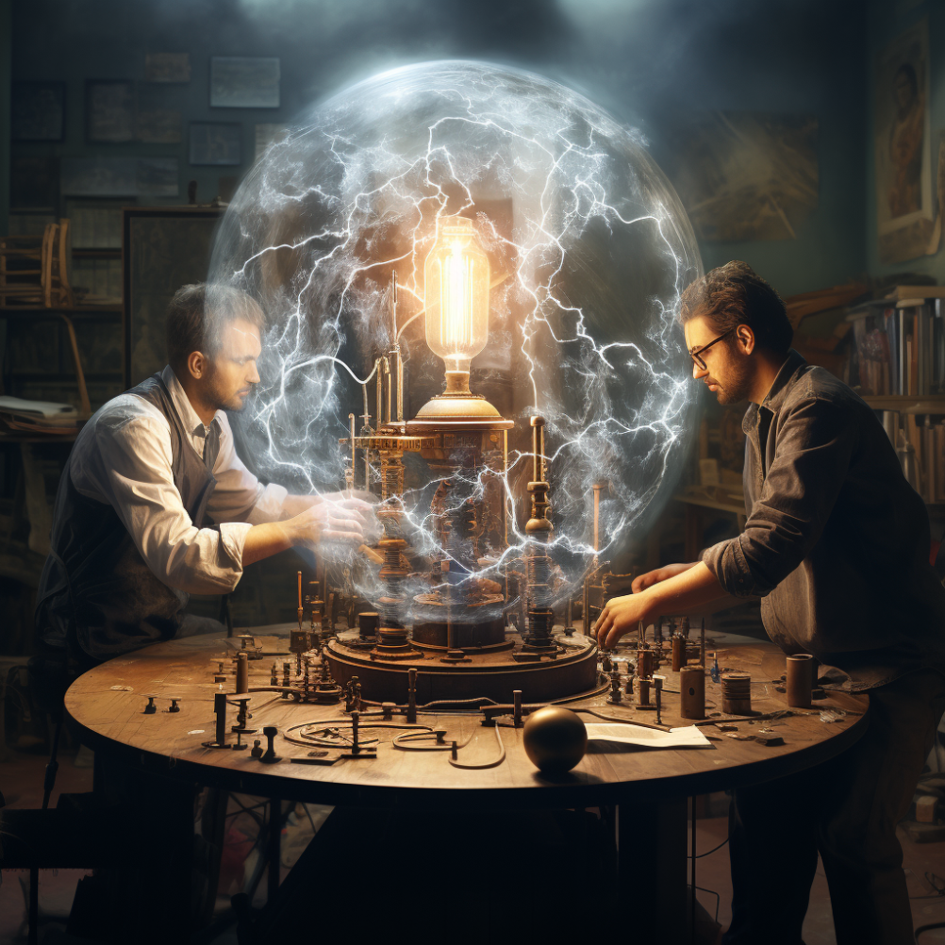
AI is a General Purpose Technology
100 years ago, electricity transformed every industry
AI is bringing an equally big transformation

Slide 6
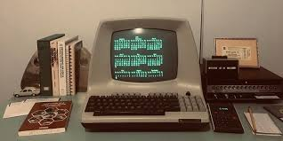
Historical Perspective on Computing
Hyper-Literal Nature
80 Years of Literal Interpretation
Lack of Reasoning Skills
Modeled After the Calculator

Slide 7
Key Concepts
Natural Language Generation (NLG)
Natural Language Understanding (NLU)
Notes:
Large Language Models (LLM) – Trained on vast amounts of data & algorithms and can understand and generate human-like text.
Natural Language Understanding (NLU) - Enables machines to comprehend and interpret human language.
Natural Language Generation (NLG) - Creating human-like text from data or pre-existing text, enabling machines to communicate with people in a natural and intuitive way.

Slide 8
What is Generative AI?
Generates text, images, videos, music, and voice
Large Language Models (LLMs)
Notes:
Large Language Models (LLM) – Trained on vast amounts of data & algorithms and can understand and generate human-like text.
Natural Language Understanding (NLU) - Enables machines to comprehend and interpret human language.
Natural Language Generation (NLG) - Creating human-like text from data or pre-existing text, enabling machines to communicate with people in a natural and intuitive way.

Slide 9
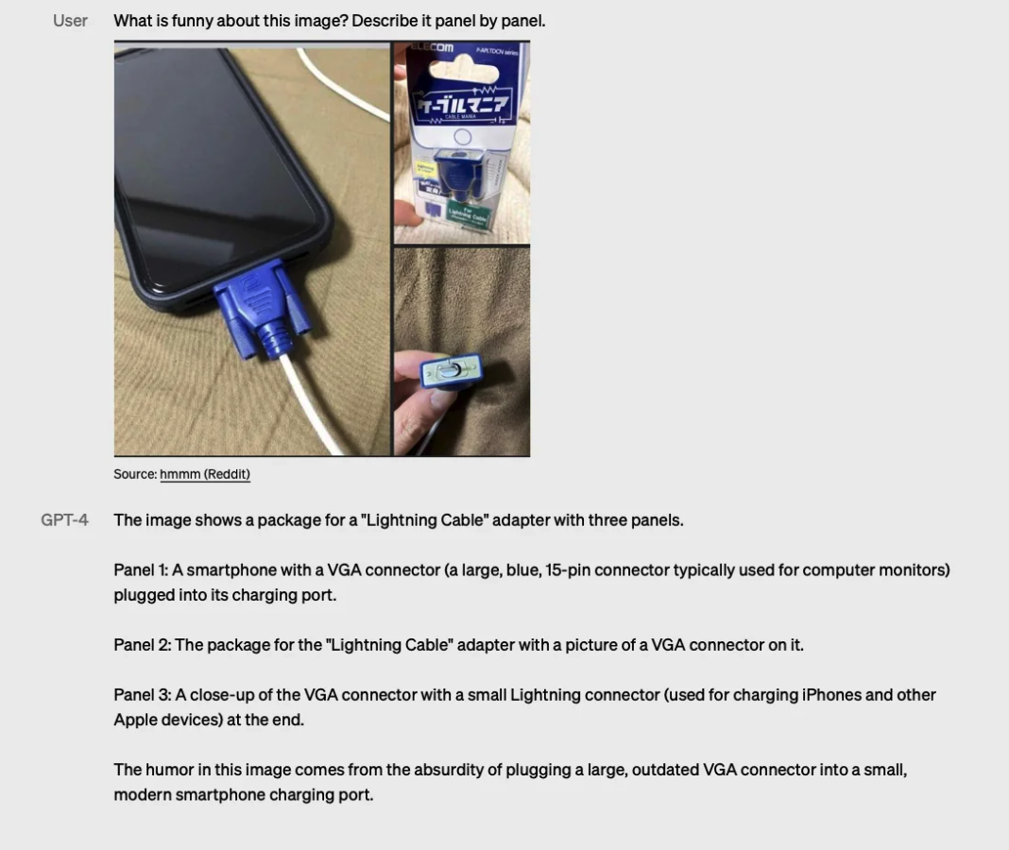
GenAI Understands Jokes
Notes:
Large Language Models (LLM) – Trained on vast amounts of data & algorithms and can understand and generate human-like text.
Natural Language Understanding (NLU) - Enables machines to comprehend and interpret human language.
Natural Language Generation (NLG) - Creating human-like text from data or pre-existing text, enabling machines to communicate with people in a natural and intuitive way.

Slide 10
Model Landscape

Slide 11
Language Model Intelligence

Slide 12
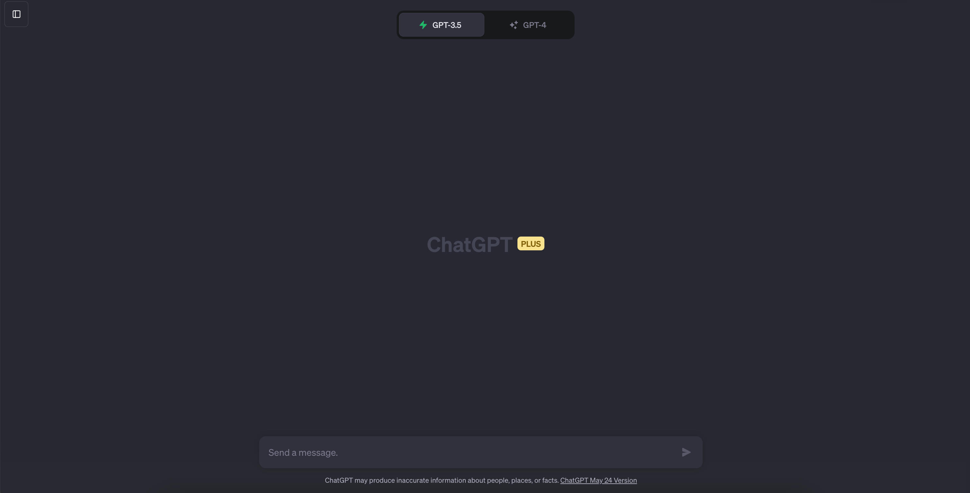
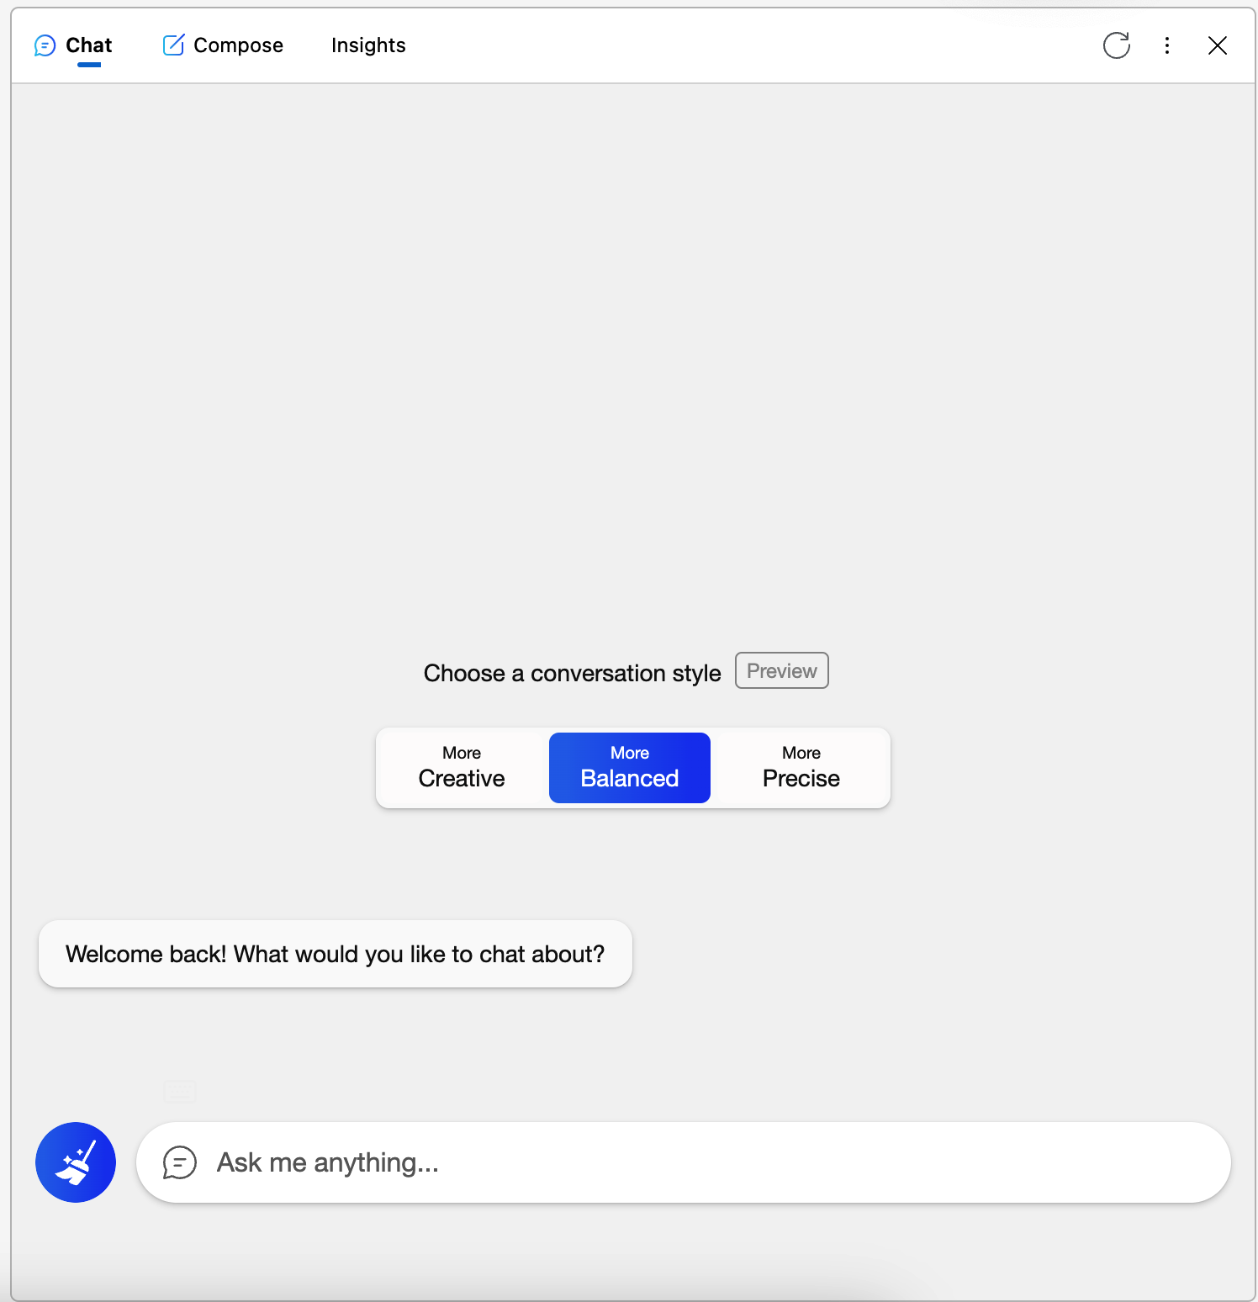
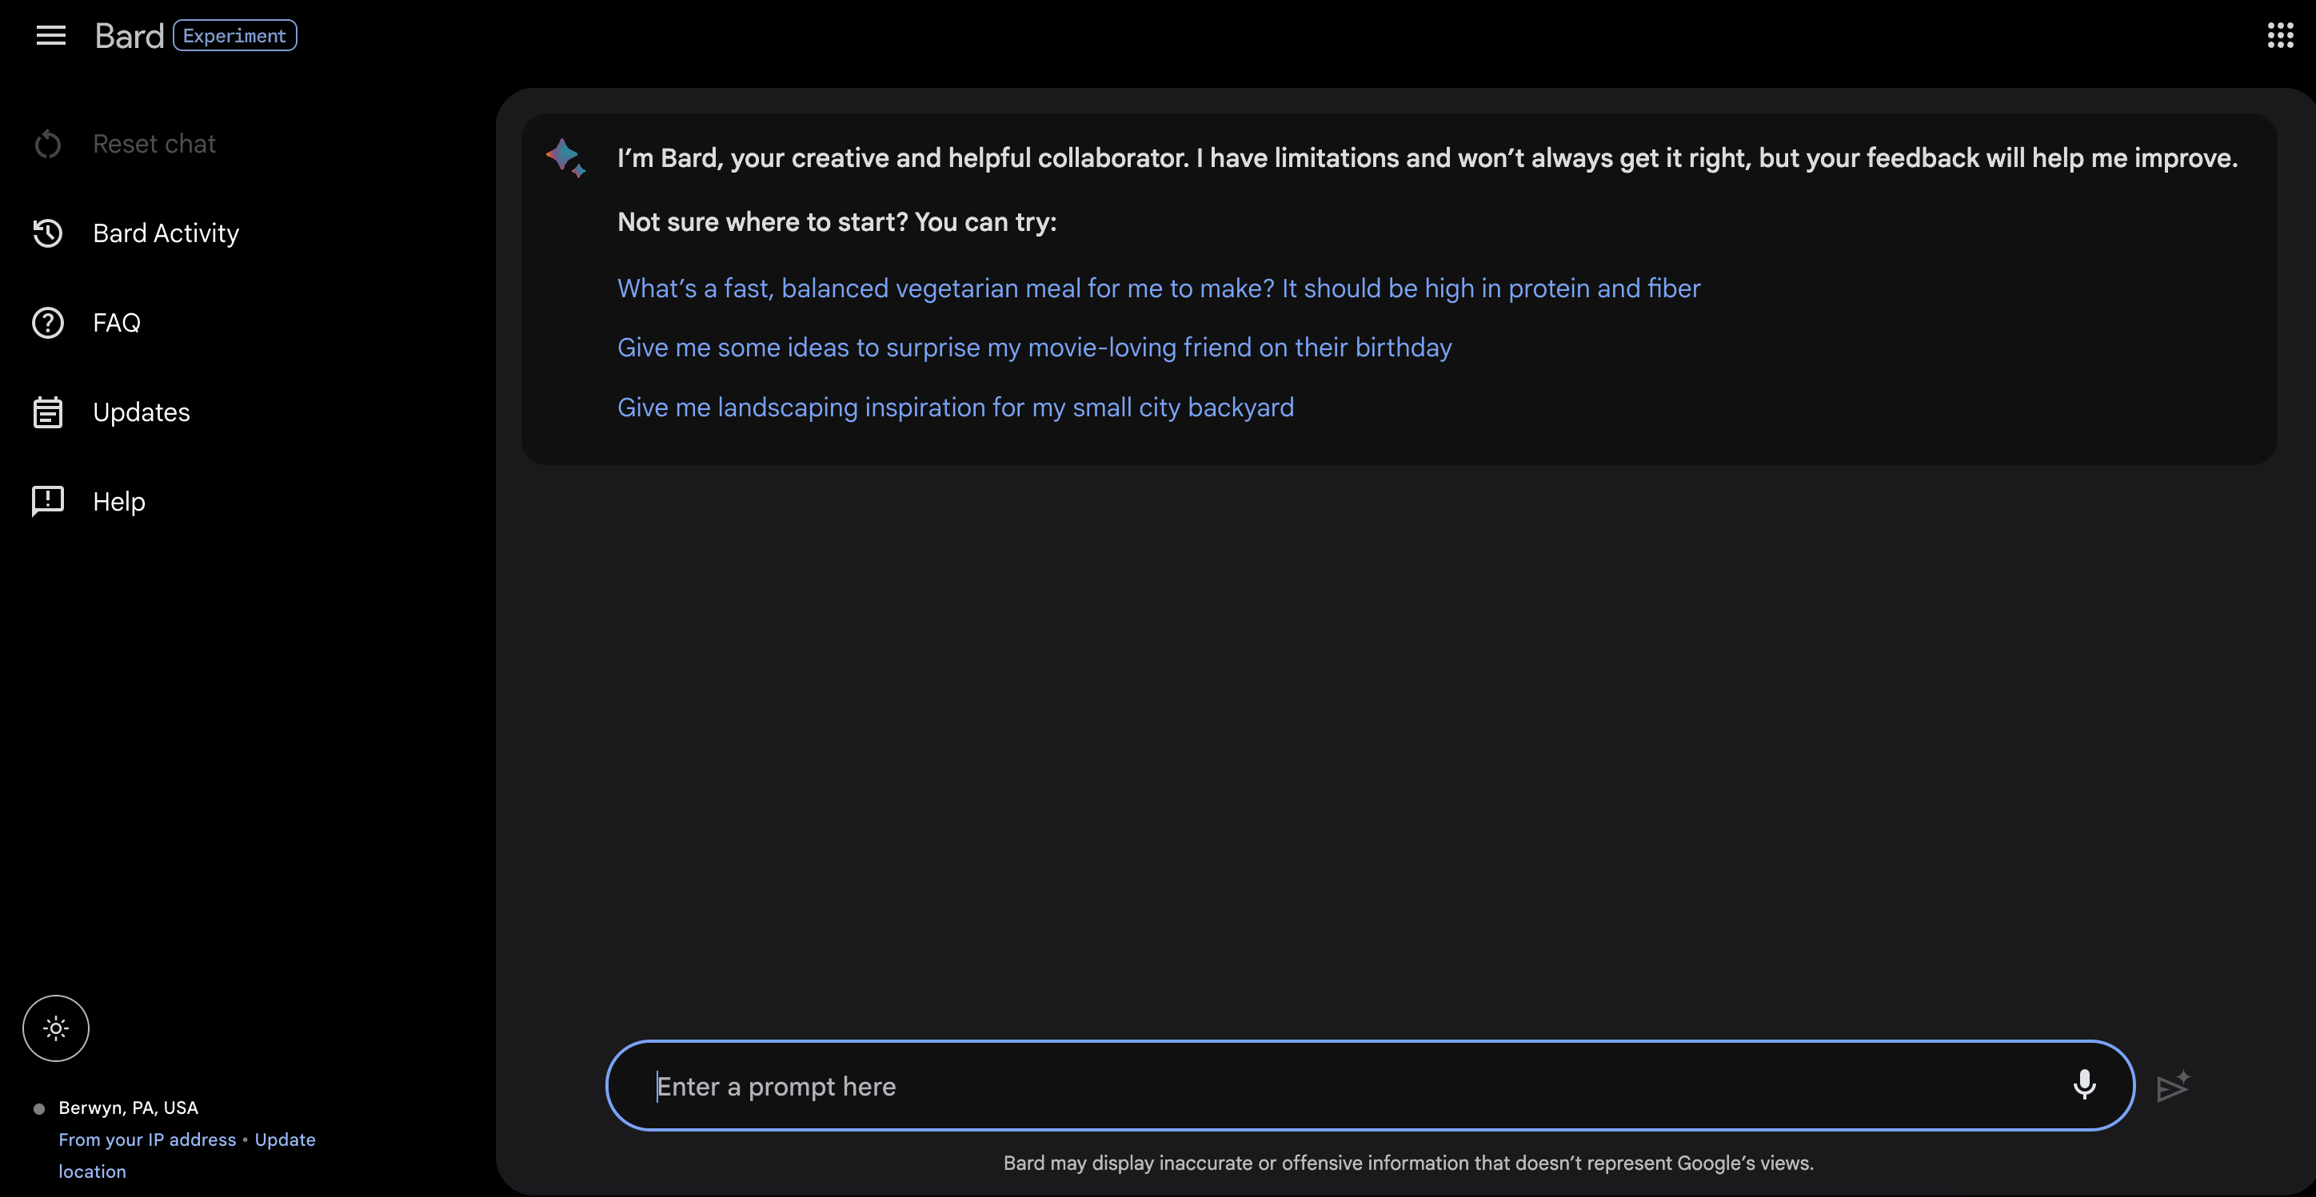
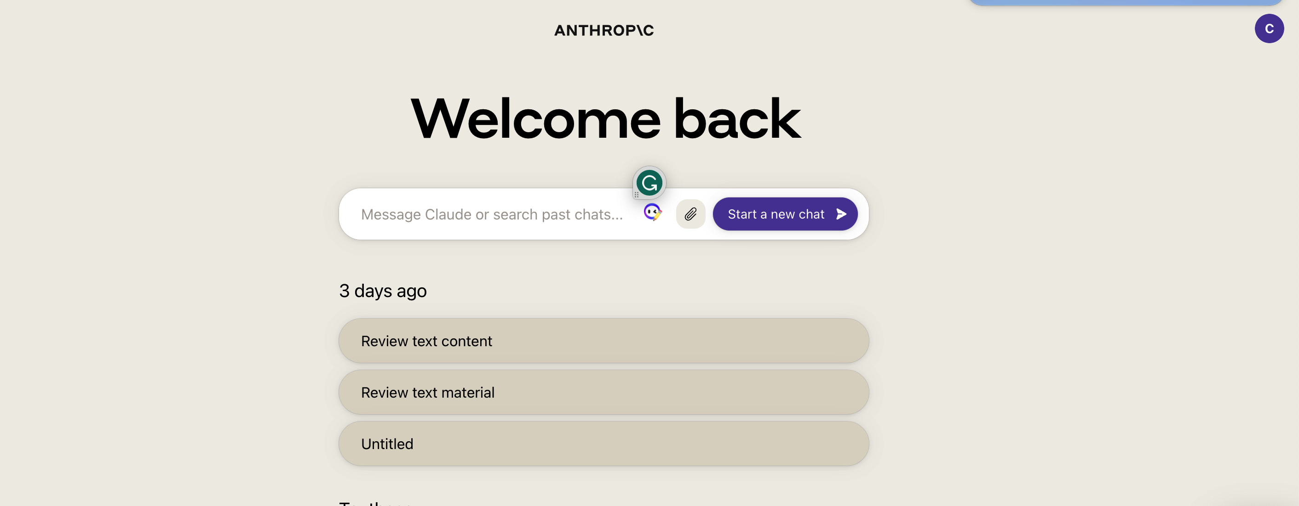
Leading Chatbots
ChatGPT
https://chat.openai.com/
Bing Chat
https://www.microsoft.com/en-us/edge
Bard
https://bard.google.com/
Claude 2
https://claude.ai/chats
Notes:
Large Language Models (LLM) – Trained on vast amounts of data & algorithms and can understand and generate human-like text.
Natural Language Understanding (NLU) - Enables machines to comprehend and interpret human language.
Natural Language Generation (NLG) - Creating human-like text from data or pre-existing text, enabling machines to communicate with people in a natural and intuitive way.

Slide 13
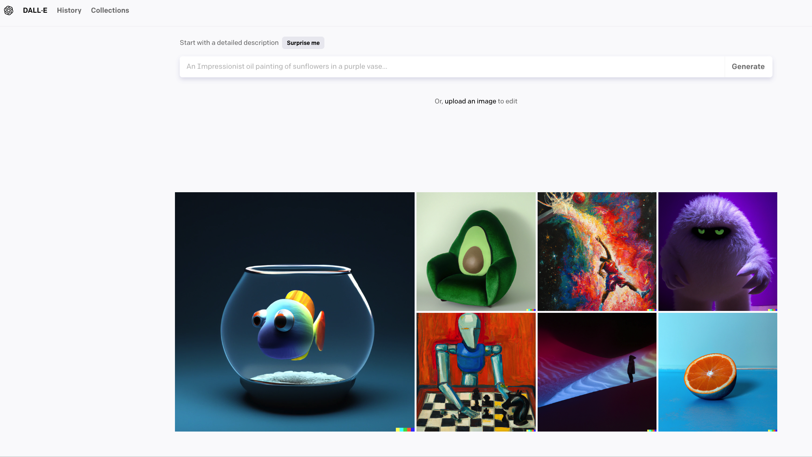
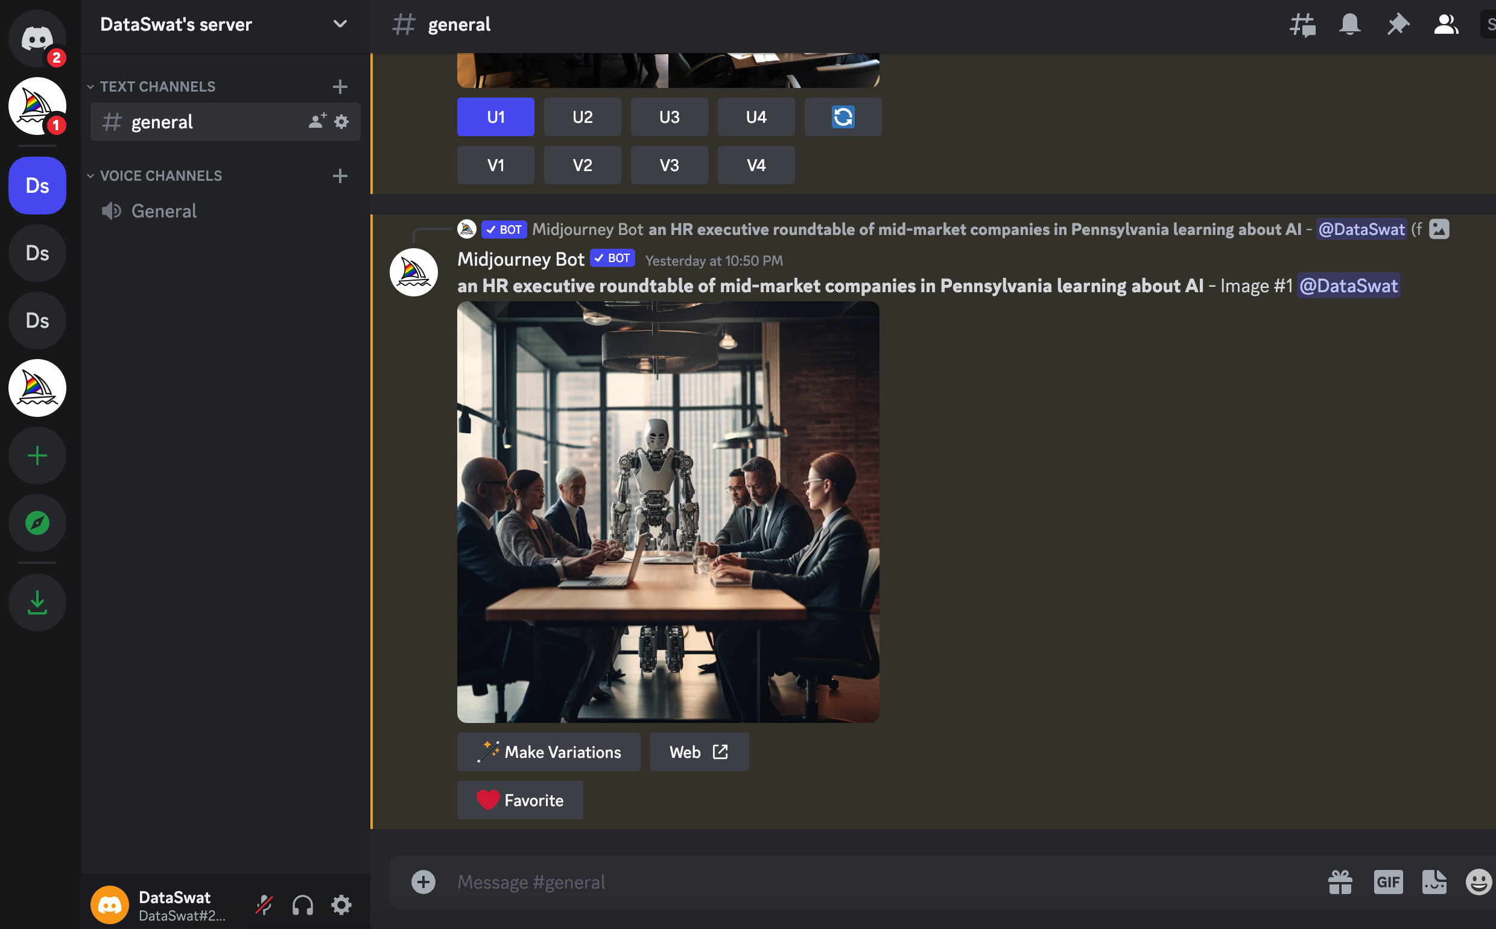
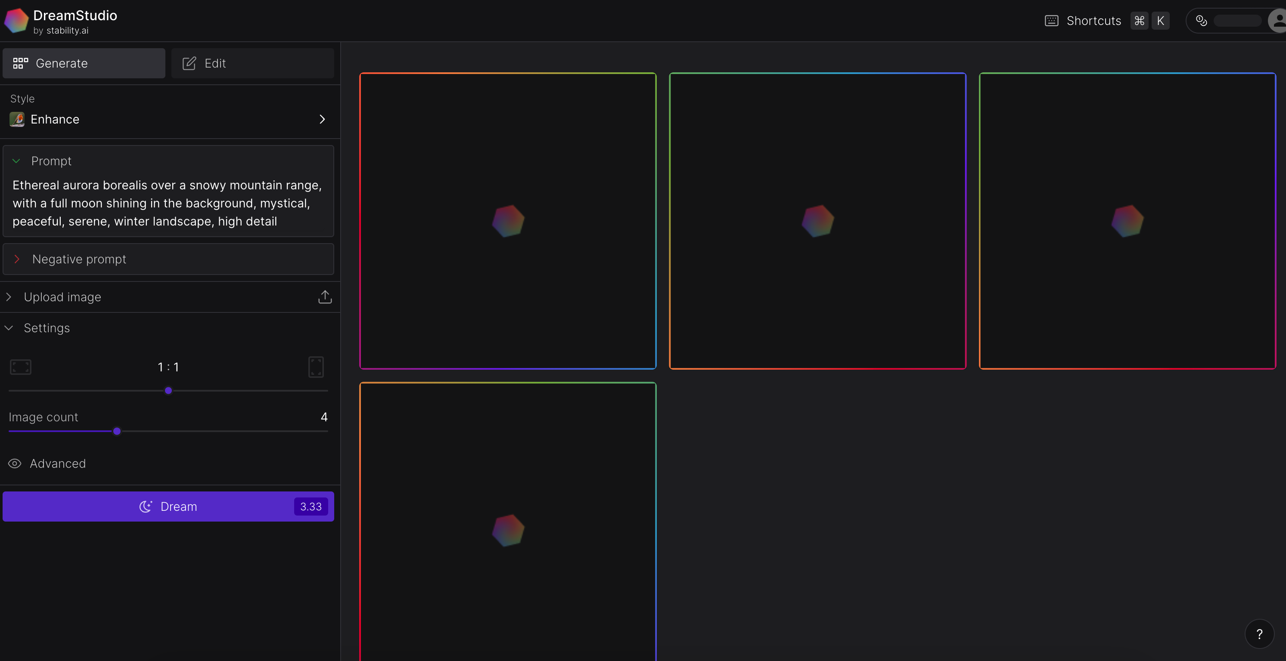
Leading Image Generators
DALL-E
https://labs.openai.com/
MidJourney
https://www.microsoft.com/en-us/edge
StabilityAI
https://dreamstudio.ai/generate
Notes:
Large Language Models (LLM) – Trained on vast amounts of data & algorithms and can understand and generate human-like text.
Natural Language Understanding (NLU) - Enables machines to comprehend and interpret human language.
Natural Language Generation (NLG) - Creating human-like text from data or pre-existing text, enabling machines to communicate with people in a natural and intuitive way.

Slide 14
Generative AI Demo
ChatGPT
Bing Chat
Bard
Midjourney

Slide 15
Data Privacy & Cyber Risks
OpenAI Consumer (ChatGPT Policy)
Data is not shared.
Data is used for model training
Option to Opt Out
OpenAI API Access to Models
Data not shared
Data not used for model training
Option to have private environment

Slide 16
Useful Resources
ChatBots
OpenAI ChatGPT Signup - https://openai.com/
Bing Chat - https://www.bing.com/search?q=Bing+AI&showconv=1&FORM=hpcodx
Bard – https://bard.google.com/
Claude2 - https://claude.ai/
Image Creator
Bing AI Image Creator - https://www.bing.com/images/create?FORM=GENILP
Recording and Transcribing Video & Audio Meetings
Otter.AI - https://otter.ai/
Learning Resources
Exploring Generative AI for Executives - https://www.claritee.ai/post/exploring-generative-ai-a-guide-for-executives
Goldman Sachs - Generative AI could raise global GDP by 7% - https://www.goldmansachs.com/intelligence/pages/generative-ai-could-raise-global-gdp-by-7-percent.html
McKinsey & Company - The economic potential of generative AI: The next productivity frontier - https://www.mckinsey.com/capabilities/mckinsey-digital/our-insights/the-economic-potential-of-generative-ai-the-next-productivity-frontier

Slide 17
Contact Info
Dan Hughes, Co-founder
Claritee.AI
dan@claritee.ai

